Slide 1

Cost Concept and Financial Ratios
Stephen Keels, CPA, PhD
Stephen.Keels@wgu.edu

Slide 2
Management Accounting verses Financial Accounting
Management Accounting:
• Unique competitive tool
• Both financial and nonfinancial data
• Usually kept secret within the company
• Used for internal planning, control, and evaluation
Financial Accounting:
• Uniform across companies (generally accepted accounting principles)
• Restricted to financial data
• Data often made public
• Used primarily by investors and creditors in deciding whether to provide capital to the company

Slide 3

Financial Accounting verses Management Accounting
Management Accounting is different from Financial Accounting in that Financial Accounting is much more directly concerned with the proper generation of and analysis of financial statement. Management Accounting is free to design an information structure that provides information and analysis so that Management may make decisions regarding the best course for their individual company. There is not a governmental agency that will dictate that managers use any indicators such as Return-on-Investment (ROI) or the Dupont. GAAP rules are usually not required for Management Accounting.

Slide 4

Management Accounting verses Financial Accounting cont.
The three process of Management Accounting are managing, controlling, and evaluating. These three are often at work at the same time.

Slide 5

Example
What does management accounting provide?
Choose 2 answers
The insight that management needs so the business can perform more effectively
The insight that outside stakeholders need to choose a company that has a competitive advantage over competitors
The detailed data that managers need to make decisions that will give the business a competitive edge
The information needed by the IRS to decide if a company should have a tax audit performed

Slide 6
Solution
The best choices were:
The insight that management needs so the business can perform more effectively
The detailed data that managers need to make decisions that will give the business a competitive edge
Do not forget that Management Accounting does not follow GAAP so it generally can not be shown outside of the Company.

Slide 7
Types of Planning
There are two types of planning: short run and long run. Short run planning includes production and operational planning.
Production planning consists of how the production is going to be accomplished while Operational planning consists of how the company is going to maximize its profits.
The two types of long-run planning consists of Strategic Planning and Capital Budgeting. Strategic planning relates to how the Company is going to place itself in the Marketplace while Capital Budgeting looks at how the Company's fixed assets are going to be acquired and maintained.

Slide 9
Example
How does management accounting differ from financial accounting?
Choose best choice:
Management accounting presents an unbiased view of a company’s economic performance.
Management accounting is used primarily for internal planning, control, and evaluation.
Management accounting is restricted to providing financial rather than nonfinancial data.
Management accounting is not used to gain a competitive advantage in the marketplace.

Slide 10
Solution
The best answer is:
Management accounting is used primarily for internal planning, control, and evaluation.
Do not forget that Management Accounting is about assisting Managers to make good decisions for the Company as opposed to providing information to Stakeholders.

Slide 11
Cost-Volume-Profit or Breakeven Analysis
The Concepts of fixed and variable cost are important to CVP Analysis. Fixed costs are costs which are not dependent of production such as rent or property taxes. Variable cost vary with production such as materials. Although this type of analysis is sometimes called Breakeven Analysis, the purpose is not to break even, but to determine how many units must be sold before the breakeven point is achieved.
Period Costs are cost that are only dependent on time such as rent or insurance. Fixed costs are costs that do not vary with the level of output such as rent or property taxes. As production increases, these fixed costs can be spread over more units so that the fixed cost per unit falls as production increases.

Slide 12
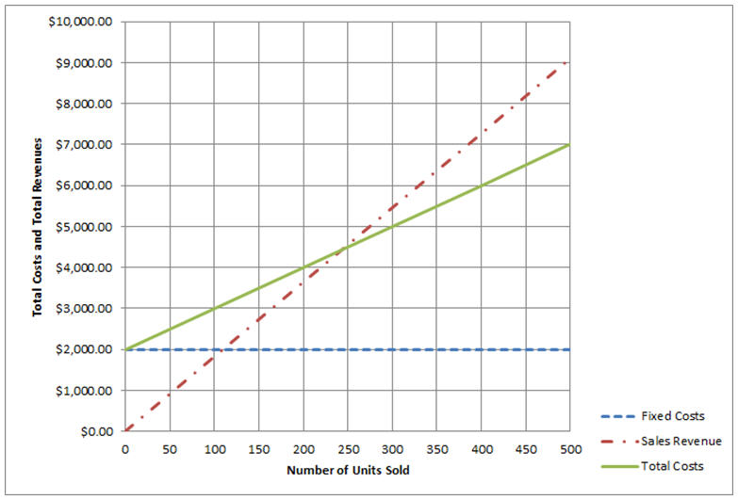
Cost-Volume-Profit Example

Slide 13
What are total revenues equal at the break-even point?
By looking at the previous graph we see that the lines cross at $4,500 so that is the correct answer.
The purpose of CVP analysis is not so much to break-even, but to get a measure for break-even so goals may be set appropriately.

Slide 14
Variable and Fixed Costs
Variable costs are the costs that vary with production such as the cost of the material used in production or the labor used to produce an item. The total variable cost increase as production increases. The difference between the sale price and the sum of the variable and fixed costs is the profit or margin. The more units that are sold, the more the fixed cost can be spread over more units, the more profit will be made since the variable cost per unit remains constant. That is why sales are so important to a firm: more sales mean more profit since the fixed cost can be spread over more units and hence, margins for each item become larger.

Slide 15
Manufacturing Costs
To help management analyze the manufacturing cost of its products, product costs are divided into three components:
• Direct materials
• Direct labor
• Manufacturing overhead
Direct materials are the materials needed to product or service.
Direct labor is the labor needed to produce the product or service.
Manufacture overhead are all the cost directly associated with the production of the product or service.

Slide 16
We generally think of a manufacture when we think of product cost, but often a service firm such as an accountant or a plumber may have product costs as well.

Slide 17
Expenses verses Opportunity Costs
Out of pocket expenses are costs that used or will require cash while Opportunity Costs are the value of the option not utilized: the cost of not doing something.
Costs can be categorized in a variety of ways depending on the decision that is being made. The most important
categorizations are as follows:
Fixed/ Variable Fixed—A cost that doesn’t change based on changes in the level of sales or production.
Product/ Period Product—A cost incurred as part of the production process.
Product Costs Direct materials—The cost of the primary raw materials used in production.
Direct/Indirect Direct—The costs that are created by a particular product or segment that is being analyzed. Differential—A future cost that can be changed by a decision made now.
Out-of-pocket/Opportunity Out-of-pocket—Costs that involve the outlay of cash or the use of some other asset

Slide 18
Types of Costs
Direct costs are associated with a branch or product alone.
Indirect costs affect more than one product or branch.
Differential cost are costs that make a difference. If your Company is going to suffer the costs regardless of the choice, then it is not a differential costs.
Sunk costs are costs that occurred in the past and there is not a way to recover them.

Slide 19
Common Financial Ratios
The debt ratio is computed as liabilities divided by assets.
This ratio is used to indicate the level of debt that the Company is maintaining.
This ratio may be used to compare similar companies to suggest if a company may be holding excessive debt.
If Sears has a total liability of 25 Million and the total value of the Common Stock is 50 Million, them its Debt Ratio is 25/50 or 50 percent.

Slide 20
The Current Ratio and Return on Sales
The current ratio is computed by taking current liabilities and dividing it by the current assets.
This ratio indicates the Company’s ability to pay its obligations in the short run.
If Sears has current liabilities of 20 million and 25 million in current assets, then the current ratio is 20/25 or 80 percent.
The return on sales is computed by diving the net income by the total sales.
This gives a measure of how much profit the company from its sales.
If a Company is not meting its sales goals, it may offer discounts which will reduce this ratio. If General Motors has net income of 100 million on 500 million in sales, then the return on sales would be 100/500 or 20 percent.

Slide 21
The Price Earnings Ratio
The Price-Earnings-Ratio is computed by dividing the total price of the common shares by the net income of the Company.
This is giving a measure of how much income the Company is making for each dollar that has been invested.
If Acme Company has 50 million in common stock and 10 million in net income, the Price-Earnings-Ratio would be 50/10 or five.

Slide 22


Return on Equity
Return on Equity is computed by taking net income and dividing it by Stockholders Equity.
This gives a measure for how much profit is being made with the money invested by the owners.
If Acme Company has a net income of 10 million and a total common stock valued at 50 million, then then Return-on –Equity would be 10/50 or 20 percent.

Slide 23
Asset Turnover
Asset Turnover is computed by dividing sales by total assets.
This ratio gives a measure for how efficiently the firm is using its assets. Companies should be compared with similar companies.
If a Wal-Mart store has $10,000 in sales and $50,000 in assets, then its Asset Turnover would be 10,000/50,000 or 20 percent.

Slide 24
Partial financial information for a company is as follows: What is the price-earnings (PE) ratio for this company?
Current assets | $36,543
Total assets | $58,719
Current liabilities | $24,824
Total liabilities | $48,561
Stockholders' equity | $10,158
Sales | $46,997
Net Income | $ 3,761
Market value of shares | $41,316

Slide 25
Solution
The Price Earning Ration equal the price of the common stock divided by the earnings or net income
Which in this case would be $41,316 divided by 3,761 which equals 10.99.

Slide 26
Example 2 What does it mean if a company has a debt ratio of 101.5%?
Solution: If a company has a debt ratio 101.5%, the that means that that liabilities divided by stockholder's equity is equal to 101.5 percent. The only way for this to happen is for liabilities to be 1.5% larger than the stockholder’s equity. This means that the company owes more to creditor than the total amount of capital contributed by investors. This may or may not be concerning to potential investors. Sometimes small start-up companies have a small capital base because most of the capital is supplied by debt instruments.

Slide 27
Example 3 A Company builds tables for retail sale. Which of the following would be considered fixed costs?
Raw wood for the tables
Craftsman per-hour wages
Rent for the building
The Receptionist for the Company

Slide 28

Solution
The raw wood and the Craftsman hours would be considered variable cost because they very with production. The Rent and Receptionist’s wages would be considered fixed because they do not depend on the level of production.

Slide 29

What is the price-earnings (PE) ratio for this company? Partial financial information for a company is as follows:
The price-earnings ratio would be the market value of the shares divided by the earnings or $41,316/$3,761 or 10.99
Current assets | $36,543
Total assets | $58,719
Current liabilities | $24,824
Total liabilities | $48,561
Stockholders' equity | $10,158
Sales | $46,997
Net Income | $ 3,761
Market value of shares | $41,316

Slide 30
Example
What does it mean if a company has a debt ratio of 101.5%?

Slide 31
Solution
If a Company has a debt-to-equity ratio of 101.5% then the company has 1.5% more total liabilities than total assets. This ratio is important because if a Company has a lot of debt relative to its assets, it will not have funds available to pay dividends, maintain assets, or invest in the company.

Slide 32
Example Which two cash flow adequacy ratios represent a cash cow?
$4,510 / $4,932
$6,991 / $5,486
$8,091 / $9,374
$5,220 / $1,875
$7,589 / $9,210
Choose 2 answers

Slide 33
Solution
Cash Flow Adequacy Ratio is determined as the ratio of net free cash flow to the average annual value of debt for the future periods. This average annual amount of debt payments helps to smooth the uneven payments of a principal debt so when this ratio is greater than one, we say the Company is a cash cow. The two ratios that were larger than one would be the correct answer. Companies like to acquire cash cows because they create more net cash available for the Company.

Slide 34
Example
Which formula yields a cash times interest earned ratio of 11?
Cash before interest and taxes of $11,000 / cash paid for income taxes of $1,000
Cash before interest and taxes of $11,000 / cash paid for interest of $1,000
Cash before interest and taxes of $11,000 / cash from operations of $1,000
Cash before interest and taxes of $11,000 / cash paid for acquisitions of $1,000

Slide 35
Solution
The correct answer is:
Cash before interest and taxes of $11,000 / cash paid for interest of $1,000

Slide 36
Any Questions?

